Slide 1
DSN Radar Imaging of Near-Earth Asteroids
and Planetary Defense
Lance Benner
Jet Propulsion Laboratory
California Institute of Technology
Goldstone-Green Bank Radar images of 2003 SD220
© 2020 California Institute of Technology. Government sponsorship acknowledged.

Slide 2
What is a Near-Earth Asteroid?
Asteroids are rocky or metallic objects, or inactive comets, that approach within 0.3 au of
Earth’s orbit around the Sun
1 au = Astronomical Unit = 150 million km or 93 million miles

Slide 3
Why Are Near-Earth Asteroids Important?
Earth impact hazard
Source of meteorites
Delivery of water and amino acids to Earth
Impacts dominate the geologic history of the inner solar system
Some are dormant or dead comets
Resources: metals and water
Targets of robotic and future human missions

Slide 4
Example of an Asteroid Orbit: 2009 DL46 Actual positions on 2016 Jan. 6
Credit: ESA-NEO Coordination Centre

Slide 5
How Many Near-Earth Asteroids Exist?
Diameter Number Earth Impact Frequency
1 km 940 1 million years
100 m 20,000 10,000 years
10 m 30 million 10 years

Slide 6
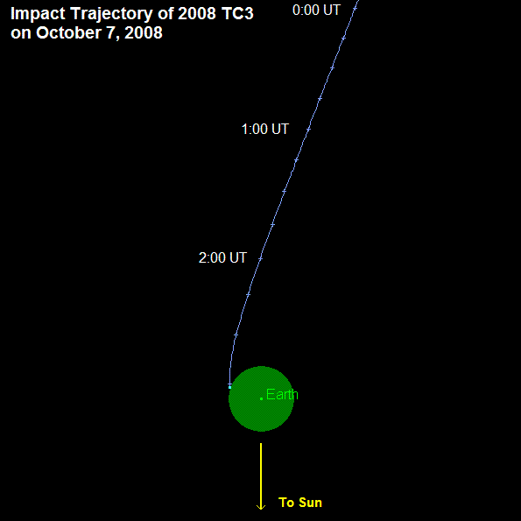
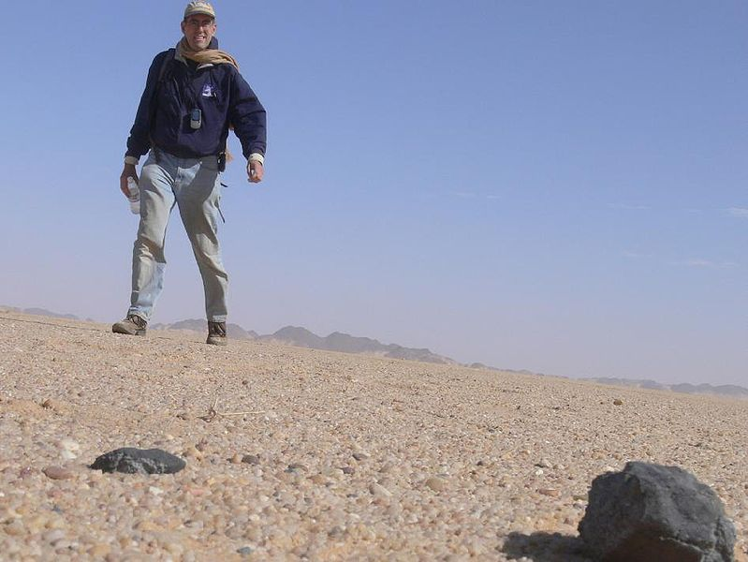
2008 TC3: 1st Asteroid Discovered Before Impact Sudan, October 2008
Pre-Impact Diameter: ~3 m

Slide 7
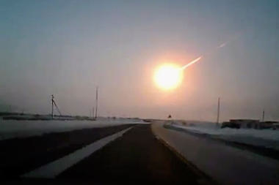
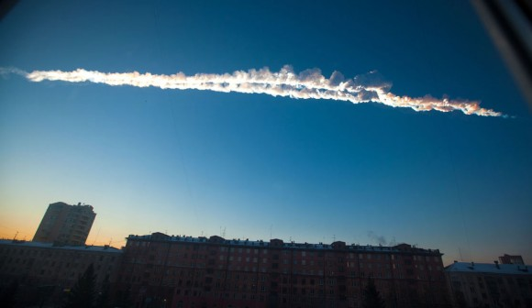
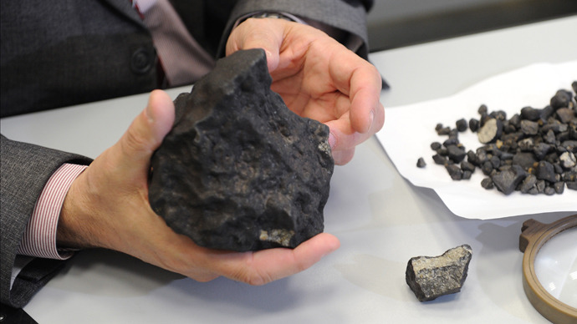
Chelyabinsk, Russia Airburst February 15, 2013
Diameter ~ 20 m
Exploded ~ 30 km up
1300 people injured (all survived)
Energy: ~30x World War 2 atom bombs
(P. Brown et al.)

Slide 8
Earth Impact Craters Number = 188
Meteor Crater, Arizona
Credit: Planetary and Space Science Centre, Univ. of New Brunswick

Slide 9
How Do We Find Near-Earth Asteroids?
Most asteroids are discovered with telescopes in Arizona and
Hawaii that are funded by NASA.
Broad goal: Find asteroids as early as possible and measure
their locations regularly.
Searches are designed to find asteroids many years before any
potential impact so there’s plenty of time to prepare.
Four asteroids a few meters in diameter have been found before
impact: all disintegrated in the atmosphere.
Number of near-Earth asteroids discovered: 22,476
(as of April 17).

Slide 10
ZTF
1.2 m
Caltech
Palomar Mountain, CA

Slide 11
NASA’s Near-Earth Object Survey Mission
A new space telescope scheduled for launch in 2025 or 2026.
Will discover 90% of NEAs > 140 m in 10 years and estimate
their diameters.

Slide 12
Radar Observations of Asteroids
Radar is a powerful technique for studying the
physical properties of near-Earth asteroids
and improving their orbits
Obtain images with up to 2-meter resolution: Greatly exceeds detail visible in any ground- or space-based optical telescope; see surface features; estimate shapes, sizes, spin states; constrain compositions.
Identify double and triple asteroids: estimate orbits, masses and densities; constrain interiors; study orbital dynamics.
Measure distances and velocities: Very precise: often within 50 meters. Improve our knowledge of asteroid orbits around the Sun dramatically. Predict asteroid motion for centuries.
Radar imaging is comparable to a spacecraft flyby

Slide 13
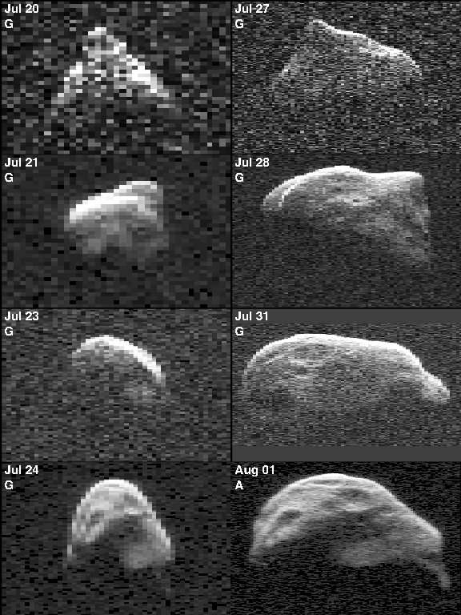
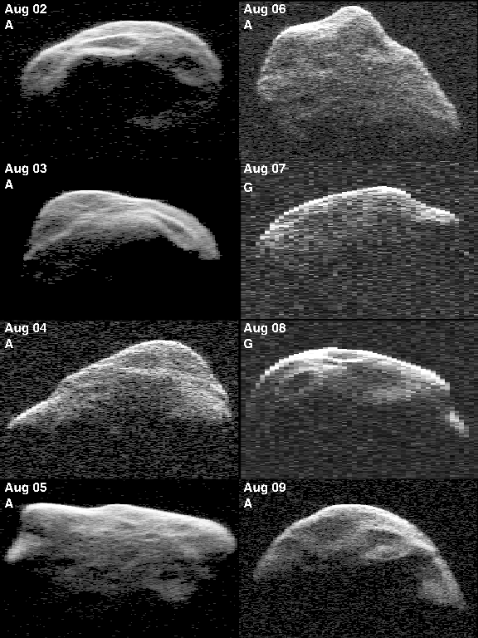
Examples of Radar Images: 1999 JM8 Diameter = 7 km, Tumbling Rotation
Benner et al. 2002

Slide 14
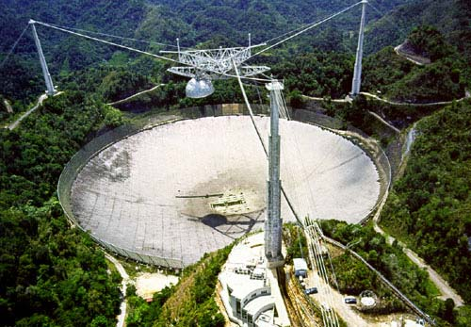
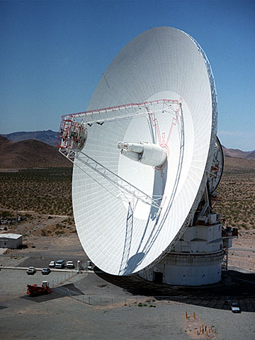
Radar Telescopes
Arecibo, Puerto Rico
NSF, NASA
Diameter = 305 m
Transmitter power = 900,000 W
Finest Resolution: 7.5 m
Goldstone, California
NASA
Diameter = 70 m
Transmitter power = 450,000 W
Finest Resolution: 3.75 m

Slide 15
3-D Shapes: Toutatis
Data
Shape
Model
Radar images are similar to ultrasound images
NOT the same as images from digital cameras!
Ostro et al. 1999

Slide 16
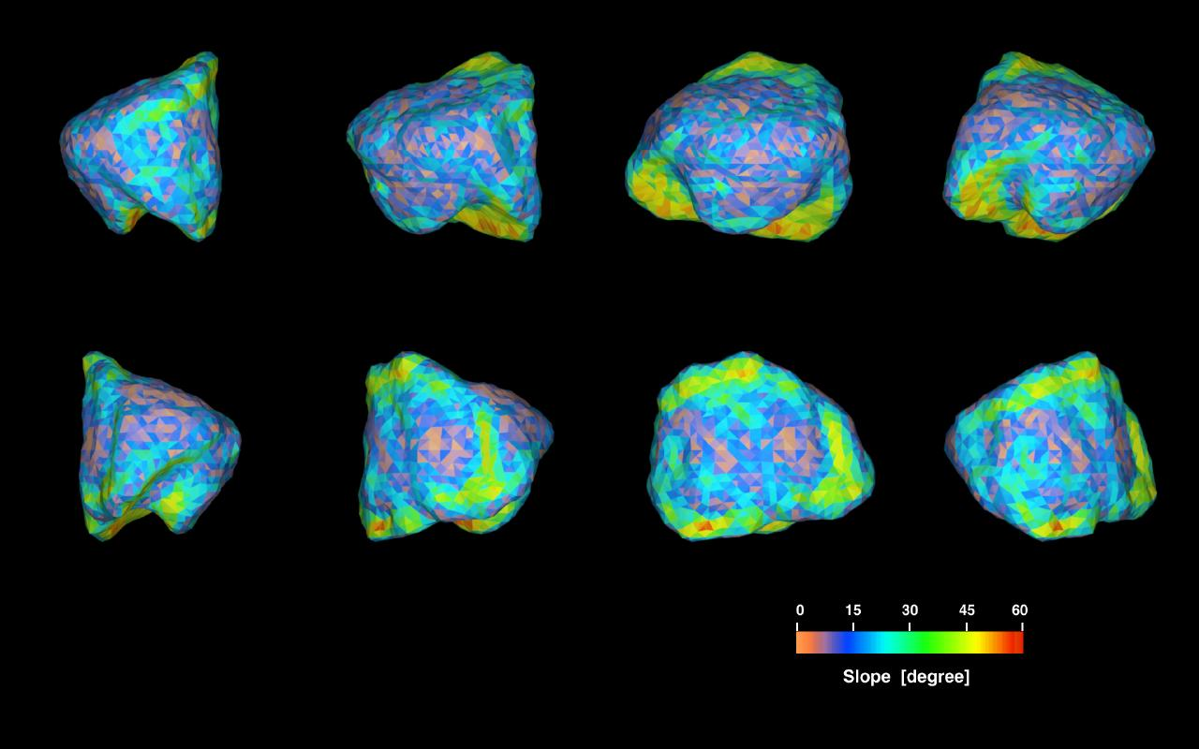
Asteroid Golevka: Gravitational Slopes and Yarkovsky Effect Detection
Shape & Gravitational Slopes
Yarkovsky Effect Drift
Hudson et al. 2000
Chesley et al. 2003

Slide 17
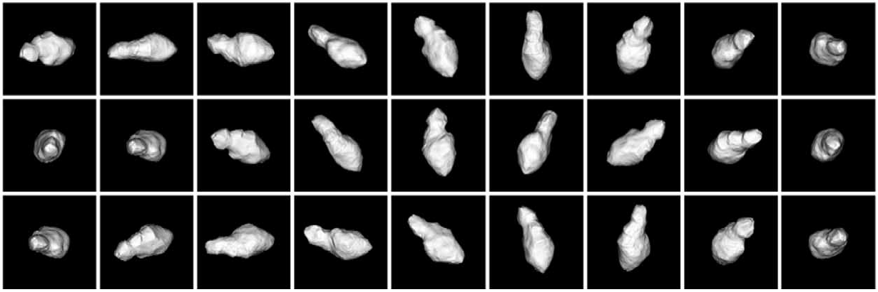
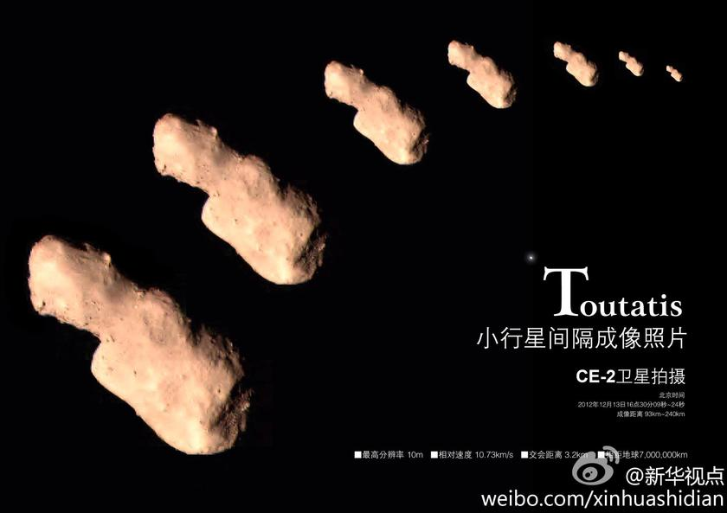
Asteroid Observed by Radar and a Spacecraft: Toutatis
(Hudson et al. 2003)
Chang’e 2
spacecraft →
images

Slide 18
Asteroid Bennu: NASA’s OSIRIS-REx Spacecraft Target:
Shape estimated from radar images was a key part of mission selection
Density: 1.190+-0.013 g/cm³
Only slightly more dense than water!
Porosity: ~50%. Not a solid object!
It’s a collection of blocks.
OSIRIS-REx Image
Oct. 2018
OSIRIS-REx = Origins, Spectral Interpretation, Resource
Identification, Security, Regolith Explorer

Slide 19
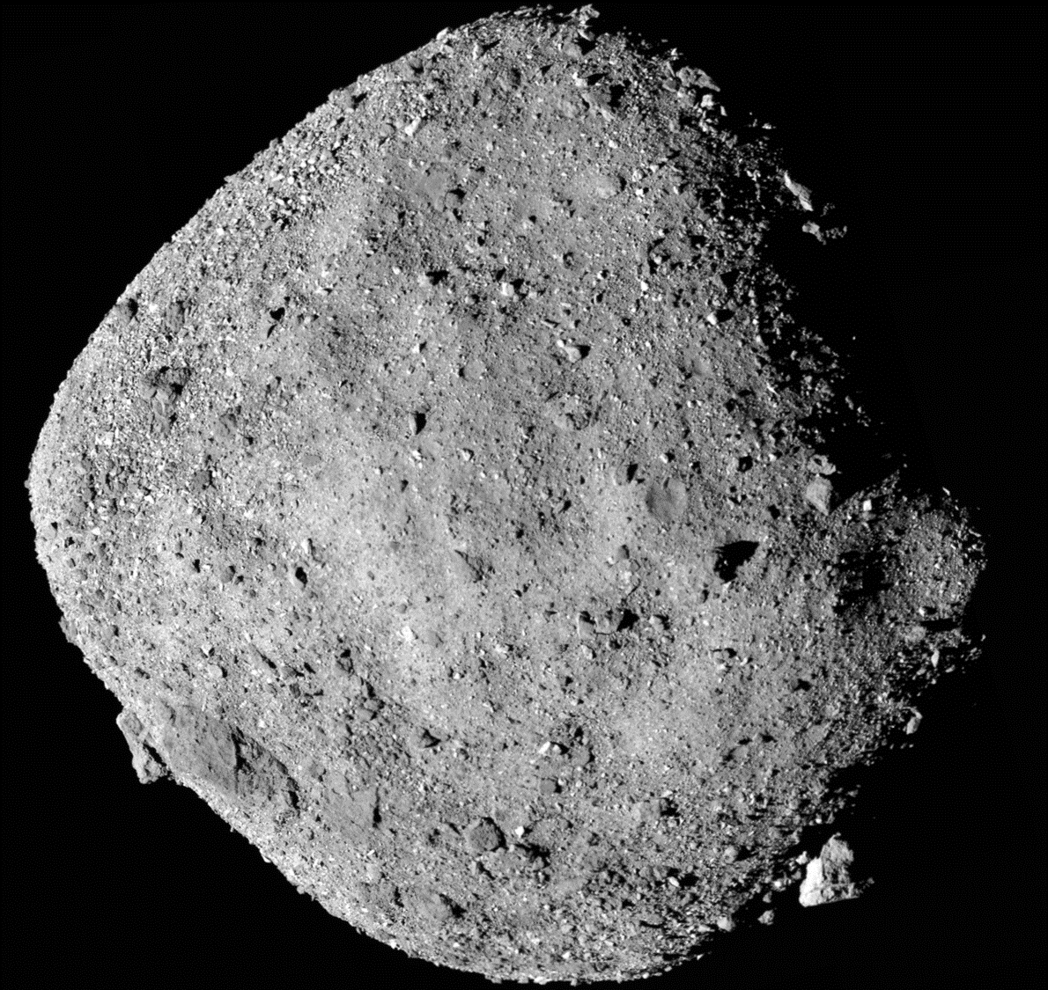
OSIRIS-REx Spacecraft Image of Bennu
OSIRIS-REx spacecraft will return samples to Earth in 2023

Slide 20
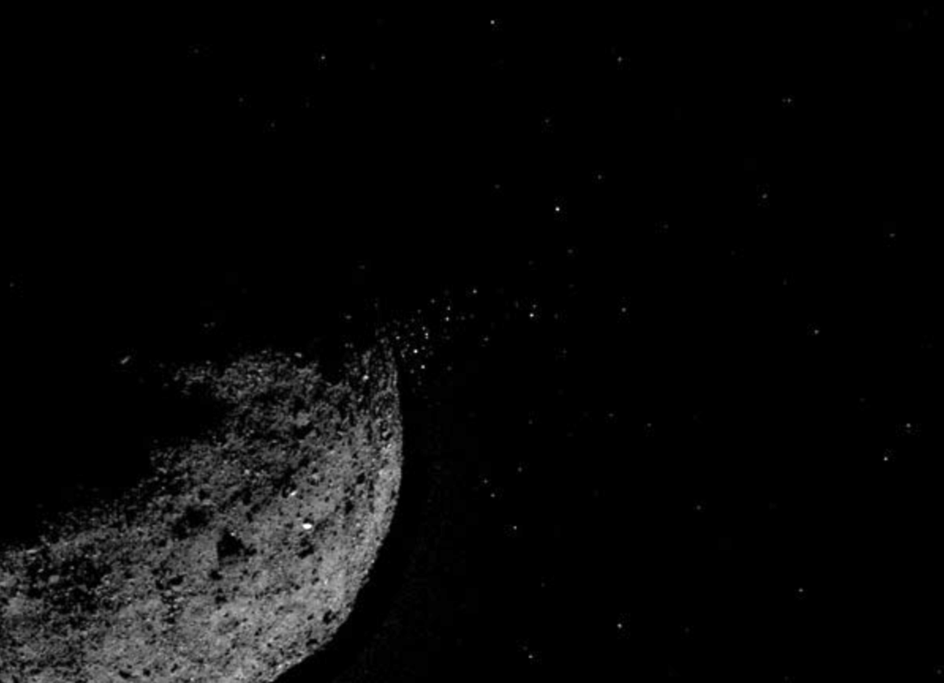
Bennu Episodically Ejects Material off the Surface!

Slide 21
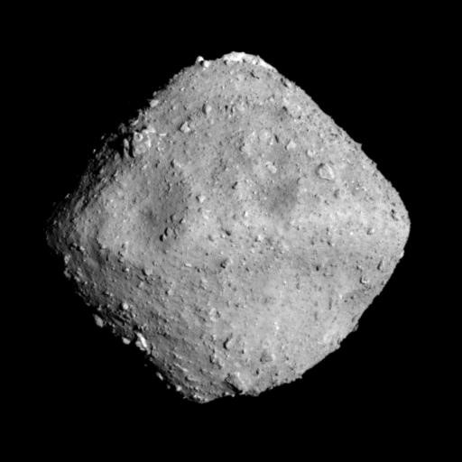
Hayabusa2 Spacecraft Image of Ryugu
Diameter = 900 m
Rotation Period = 7.62 h
Density = 1.190+-0.030 g/cm³; ~50% porosity
Radar imaging planned in Nov. 2020.

Slide 22
The DART spacecraft will hit the moon of Didymos in 2022 and change the orbital period by >1%.
Radar and lightcurve observations could show the moon’s position change within one week. Europe’s Hera spacecraft will study Didymos in 2026.

Slide 23
Double Asteroid Didymos
Target of the Double Asteroid Redirection Test (DART) Mission
Arecibo Radar Images
Shape of Didymos
Primary diameter = 780 m
Secondary diameter ~ 160 m
Bulk density = 2.1 g/cm³
Naidu et al. 2020

Slide 24
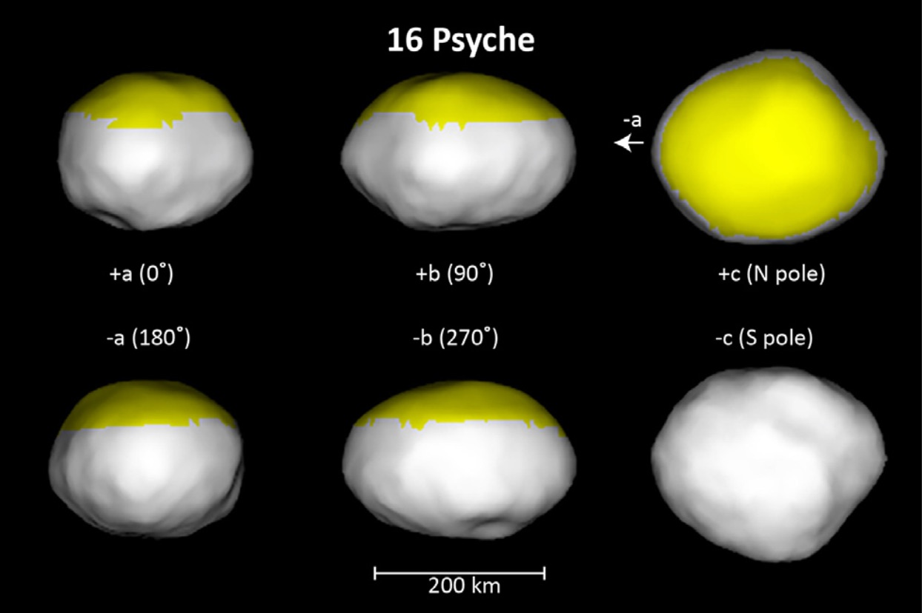
Asteroid Psyche: Target of NASA’s Psyche Mission
Made of metal! Main-Belt Asteroid.
Shepard et al. 2017
The shape was estimated from Arecibo radar images.
Spacecraft launch in August, 2022. Arrival at asteroid Psyche in 2026.

Slide 25
Asteroid Apophis
Bifurcated shape
Goldstone Radar Images, Jan. 2013
Brozovic et al. 2018
Flyby within 5 Earth radii on Friday, April 13, 2029. Visible without binoculars from western Europe, Africa, and eastern South America.
Earth’s gravity should change the rotation and be visible with radar images.
Possible NASA robotic mission target.

Slide 26
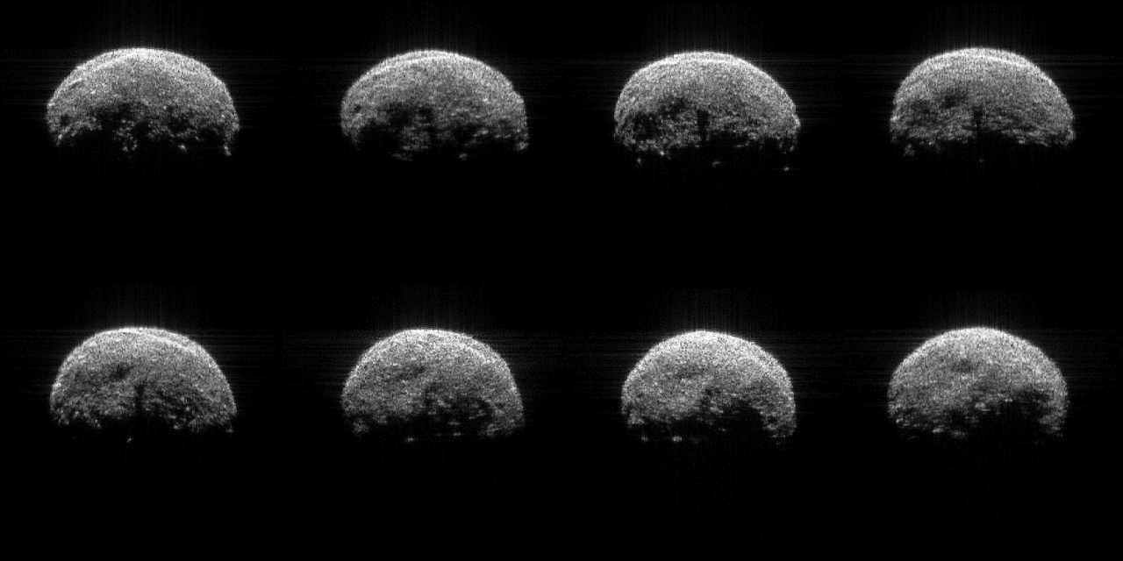
2005 YU55: Nov. 2011, Goldstone
Evidence for boulders, craters, a rounded shape,
and an equatorial bulge

Slide 27
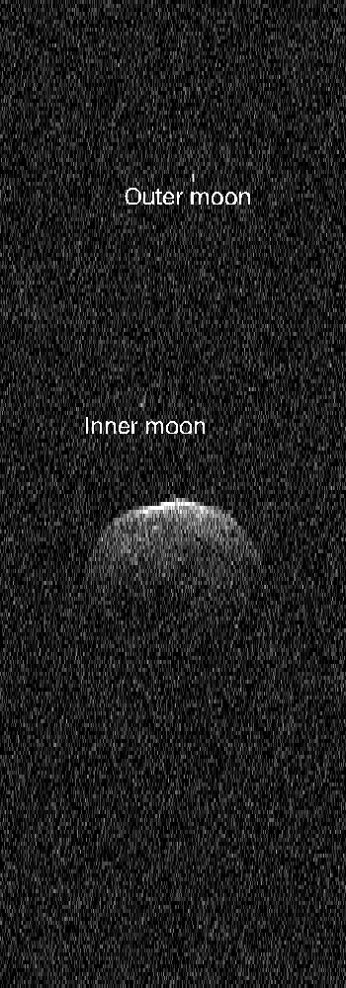
Asteroid Florence:
Triple Near-Earth Asteroid
Goldstone, Aug. 2017
Diameter = 4.5 km
Rotation period = 2.36 h
1/6 of near-Earth asteroids > 200 m
in diameter has at least one moon.

Slide 28
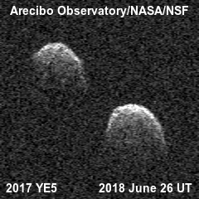
Double Asteroid 2017 YE5:
Goldstone and Arecibo Radar Images
Taylor et al., 2018

Slide 29
2014 JO25
Goldstone, April 2017
Range resolution = 15 m/pixel
Peanut-shaped asteroids are relatively common:
1/6 of near-Earth asteroids > 200 meters in diameter

Slide 30
2003 SD220
Arecibo-Green Bank Images
Range resolution =7.5 m/pixel
Dec 18
Dec 19
Dec 22
“Banana” shape is unlike any asteroid we’ve ever seen.
Rotation period ~ 12 days, but it tumbles
Long axis > 2 km
Rivera-Valentin et al. 2019

Slide 31
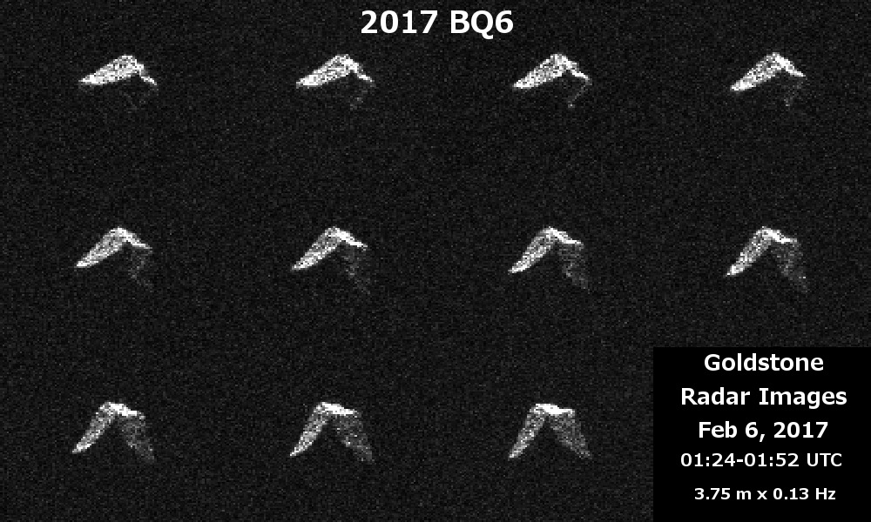
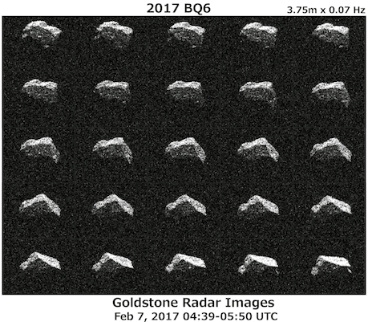
Diameter = 200 m
Period ~ 4.8 h
Puzzling, angular shape:
similar to “Dungeons
and Dragons” dice.
Lawrence et al., in prep.

Slide 32
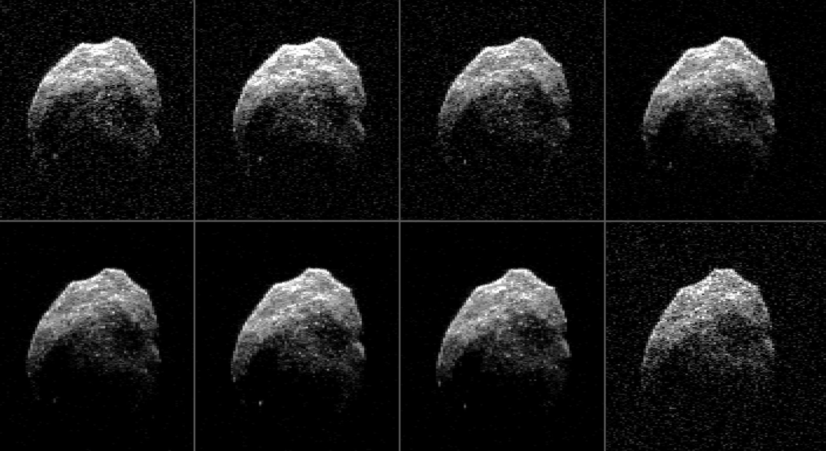
2015 TB145
Goldstone-Green Bank images. Range resolution = 3.75 m
Diameter ~ 600 m, Rotation period ~ 3 h

Slide 33
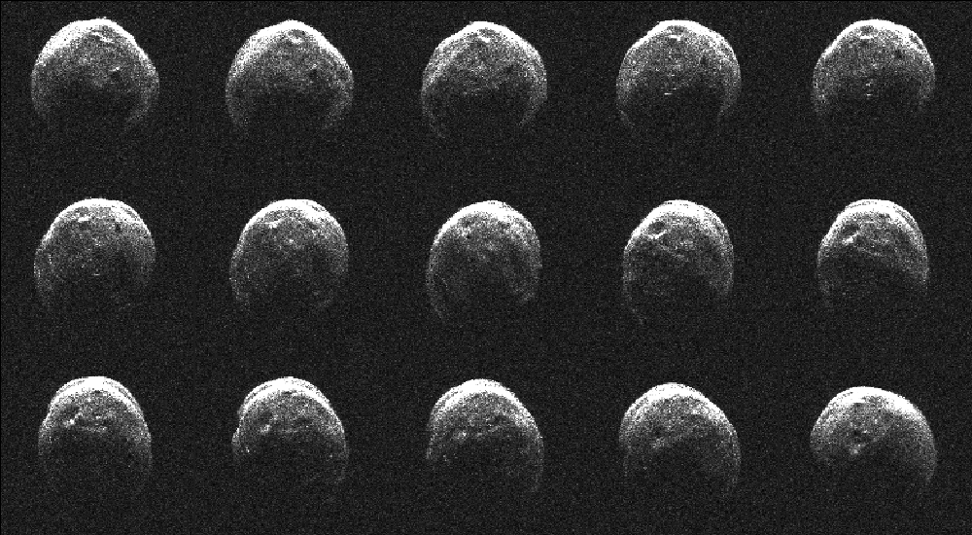
Craters and an Oblate Shape: 1998 CS1
Arecibo, Jan. 2009
Also evidence for boulders
Ford et al., in prep.

Slide 34
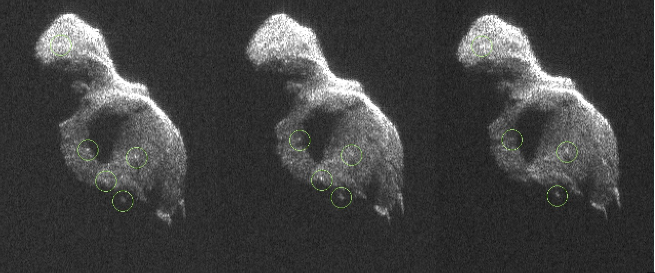
2014 HQ124: Radar Evidence for Boulders and a Crack
Goldstone-Arecibo images, Resolution = 3.75 m
Monthly report for June 2014
Long axis is about 400 meters.
Rotation period ~ 20 hours
2014 HQ124 was discovered by NASA’s NEOWISE spacecraft
34
34
34
Benner et al. 2015

Slide 35
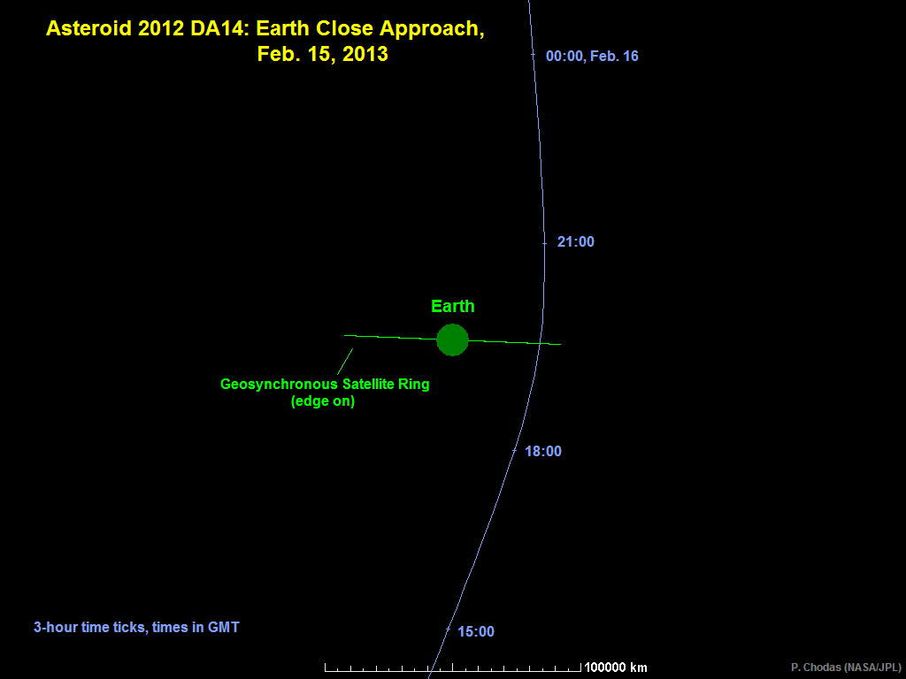
Asteroid 2012 DA14
Goldstone Images, Feb. 2013
Approach distance: 5.4 Earth radii
Diameter ~ 40 m

Slide 36
More Information is available at the
Asteroid Radar Research Website:
https://echo.jpl.nasa.gov/
2007 WV4, Goldstone radar images, June 2017

Slide 37
Backup Slides

Slide 38
Robotic Spacecraft Missions to Near-Earth Objects
Observed by Radar
Previous and Current Missions
Spacecraft Country Asteroid Name
NEAR USA-NASA Eros
Hayabusa Japan Itokawa
EPOXI USA-NASA Comet Hartley 2
Chang’e 2 China Toutatis
Hayabusa2 Japan Ryugu (Radar in Nov. 2020)
OSIRIS-REx USA-NASA Bennu
Future Missions
DART USA-NASA Didymos
LICIA cubesat Italy Didymos
Hera Europe Didymos
NEA Scout USA-NASA 2018 PK21 ?
Destiny+ Japan Phaethon

Slide 39
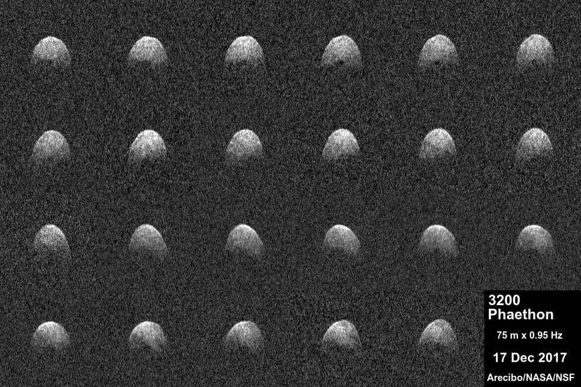
3200 Phaethon
Arecibo, 2017 Dec. 17
Target of Japan’s “DESTINY+” mission.
Source of the Geminids meteor shower. D ~ 6 km.
Taylor et al. 2018

Slide 40
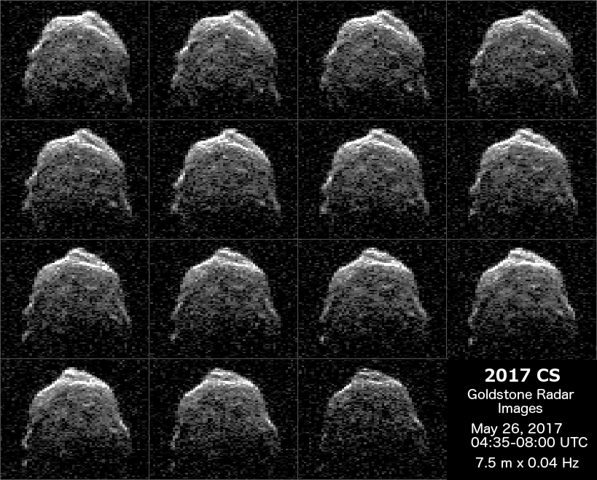
2017 CS

Slide 41
Ground Truth for Radar Models:
25143 Itokawa (2005)
Radar
Model
Hayabusa
Spacecraft
Model
References: Ostro et al. 2005, Gaskell et al. 2008

Slide 42
Goldstone DSS-13
Green Bank Telescope
NASA
California
Diameter = 34 m
Transmitter power = 80 kW
Receive at Green Bank or Arecibo
Finest resolution: 1.875 m
NSF
West Virginia
Diameter = 100 m
Used to receive
No transmitter

